Slide 1
Marine Mammal Sound Classification Using a CNN (Pattern Recognition)
CS4795 Project Proposal
Chris Higgins

Slide 2
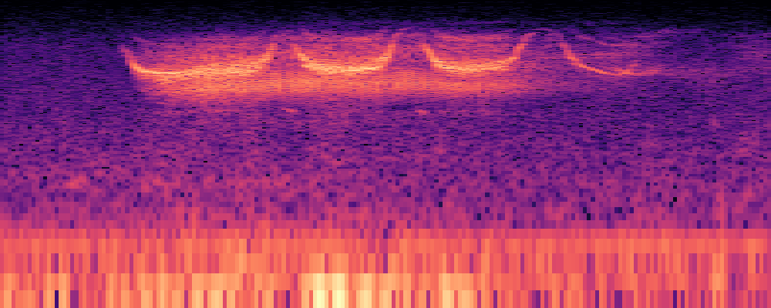
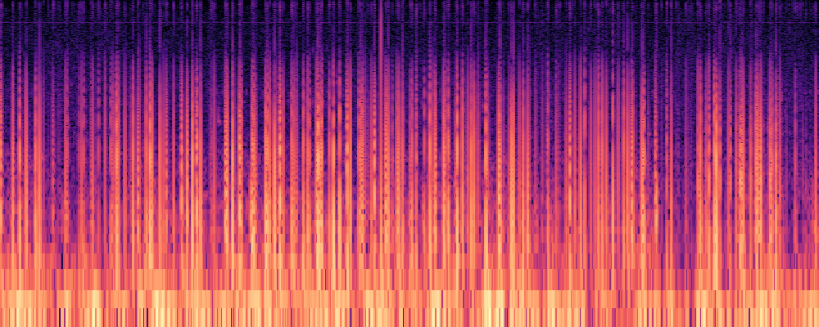
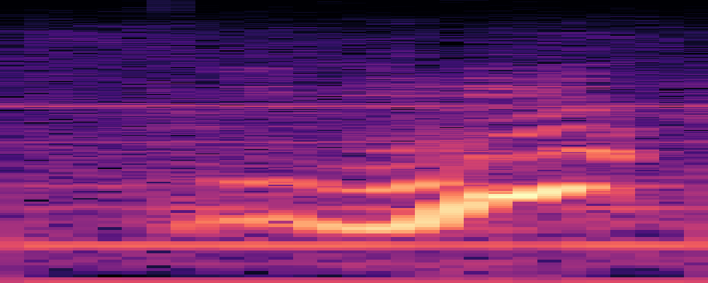
Description:
This project builds off my technical report, which is an overview of the application of CNNs for animal sound classification. I will attempt to implement a small model capable of classifying 2-3 different marine mammal vocalizations with reasonable accuracy.
Current sounds obtained:
Atlantic Spotted Dolphin
Northern Right Whale
Beluga Whale
Animals may change
ASD
Beluga Whale
NRW

Slide 3
General Methods:
Dataset Preparation:
Dataset will consist of spectrogram images generated from recordings of three different marine mammal species, using the data available from the Watkins Marine Mammal Sound Database
Model:
A pre-trained CNN with transfer learning will be used – modified to suit my needs
Training and Evaluation:
Data augmentation will be used to increase variability in training data
Assess the performance of the model

Slide 4
Expected Challenges:
Potential overlapping sounds in recordings
This can pose challenges for effective classification
Main challenge – Working with a smaller dataset
This can limit the model’s ability to generalize well

Slide 5
Goals:
Explore and highlight the challenges of limited data when training and using a CNN
Attempt to make CNN as effective as possible, given the limited data and time constraints

Slide 6
Current Bibliography:
My technical report
ChatGPT 4o
Watkins Marine Mammal Sound Database

Slide 7
GitHub:
https://github.com/chrisHigg/animal-call

